Slide 1
Main Java
Page Object Model Classes
Package - .pageobjects
Ex-Login Page,Product Catalogue,Cart
Abstract Class
Package - .AbstractComponents
Extends from POM Classes
Inheritance
Package - .resources
Property File - .properties file
ExtentReportClass - .Java

Slide 2
Page Object Classes
Package Name - .pageobjects in Main/Java
Page Object Classes has each application wise Page Factory Locators and its Action Methods
Call by creating object for all POC with Arguments(driver) from Testcases
This Driver from Test Case is passed to the Constructor with Args
Create Constructor with Args (driver,this.driver=driver/super(driver)) and initiate PageFactory.initiElements(driver,this);
Page Object Classes should not have Input data, Actions Methods will have Data as Args in Page Classes , Action Methods can be called by Object with Input Data as Args
Same Argument should be caught in Page Object Action Methods as Arguments
Ex – Main Test Case – Login. LoginApplication(Naresh,Qwerty1989)
Public void LoginApplication(String Emailid,String Password)
Use Extends from all Page Object Classes to Abstract Classes
Use Super(a) or Super(driver) as first line in child constructor to pass driver functionality from Page Object Classes to Abstract Classes, Super Keyword invokes Parent Class Constructor

Slide 3
Page Factory Locators
Locators inside Page Object Classes are called Page Factory Locators
Locators Syntax
1. @FindBy(id = "userEmail")
WebElement UserEmail;
2. @FindBy(xpath = "//div[contains(@class,'mb-3')]")
List<WebElement> products;
By ProductBy = By.xpath("//div[contains(@class,'mb-3')]");
Page Factory cannot be applied on filtered WebElements , If the previous step is filtering the Web Element based on condition and we are using findBy in filtered WebElement we cannot use Page Factory instead we can use By Locator with FindElement Syntax

Slide 4
Abstract Classes
Package Name - .AbstractComponents
Create in Main/Java
Reusable functionalities dhould be present here which are common to many Test cases
Operations like ExplicitWait, Switch to window, frames, Java Script Executor , Alert Handling
Button likes Logout , clicking Cart should also be present as these buttons will be clicking on many functionalities based on Test cases
Use Inheritance with all Page Object Classes with extends keyword
Create Constructor with Args (driver,this.driver=driver)
Should not have any PageFacotry and By Locators as all Page Object Model Classes have them and are extending to Abstract Classes
Should have locators only for reusedButtons which is being extended to Many POC like Logout/Cart

Slide 5
Properties File
Package Name - .resources
File should be .properties format
Create in Main/Java
This will have properties of our Tests like Browser
Can be Accessed by Properties Class from Base Test with below Syntax
Properties prop = new Properties();
FileInputStream fis = new FileInputStream(System.getProperty("user.dir")+“Path of file\\src\\main”);
Prop.load(fis);
Prop.getProperty(“browser”);

Slide 6
Extent Reports
Package Name - .resources for Extent Class
ExtentReports , ExtentSparkreporter are main classes
ExtentSparkreporter – provide path where report should be created in Object Creation
.Config().SetReportName(“Naresh Report”);
.Config().SetDocumentTitle(“Naresh PageTitle”);
ExtentReports – Main class
ExtentReportObject.attachReporter(SparkReporterObject);
ExtentReportObject.setSystemInfo(“Tester”, “Naresh”);
ExtentTest Test = ExtentReportObject.createTest(“TestCaseName”);
Test Object will be used for reporting pass or fail in Listeners as Test has details of Test case
Finally return the ExtentReports Object in this method and make the method static so without object we can call this method in Listeners Class by ClassName.MethodName

Slide 7
Test Java
Package - .Tests
Test Cases
Package - .TestComponents
Base Tests
Inheritance
Inheritance
Package - .Data
Test Data-Json File Input
Package - .TestComponents
Listeners,RetryANalyser

Slide 8
Base Tests
Package Name - .TestComponents
Create in Tests/Java
Just like POC inherits Abstract Components , Test Cases will inherit Base Tests
Reusable functionalities related to Browser configuration and Global Properties which are common to many Test cases
Operations like Driver Initialization , Take Screenshot , Close Application ,Close Bowser and things related to Test cases will be in Base tests
Base Tests will access Properties file through Property Class in Java
Base Test Primary Purpose is to initialize Driver object in one method , return the driver Object
Execute the Driver Method and create Object for first page of SUT in a method and return the object, by calling this method in Test our flow starts
Calling the Method executing Driver Initialization and Object for 1st page in SUT can be made as @BeforeMethod as it always needs to be executed , Make the Object as Global Class Variable so it can be used directly in Test case without even calling Method Executing Driver Initialization
Json Utlity to accept input should be in Base Test
Base Test should have @BeforeMethod and @AfterMethod

Slide 9
Take Screenshot
This Method should be in Base Test Class
public File GetScreesnhot(String TestCaseName,Webdriver driver) throws IOException {
TakesScreenshot Ts = (TakesScreenshot)driver;
File Source = Ts.getScreenshotAs(OutputType.FILE);
File Destination = new File(System.getProperty("user.dir")+"//reports//"+TestCaseName+".png");
FileUtils.copyFile(Source, Destination);
return Destination;
}

Slide 10
Listeners
Package Name - .TestComponents
Listeners Class should implement ITestListener Interface
Call Extentreports Class Method(Static) by Classname.MethodName at global level and catch using ExtentReports extent =
With this Extent we can use in all methods
OnTestStart use
ExtentTest test = extent.createTest(result.getmethod().getmethodname());
On onFinish user extent.flush();
With this Extenttest object we can use for onTestSuccess
test.log(Status.PASS, "Test Case Passed");
With this Extenttest object we can use for onTestFailure
test.fail(result.getThrowable());

Slide 11
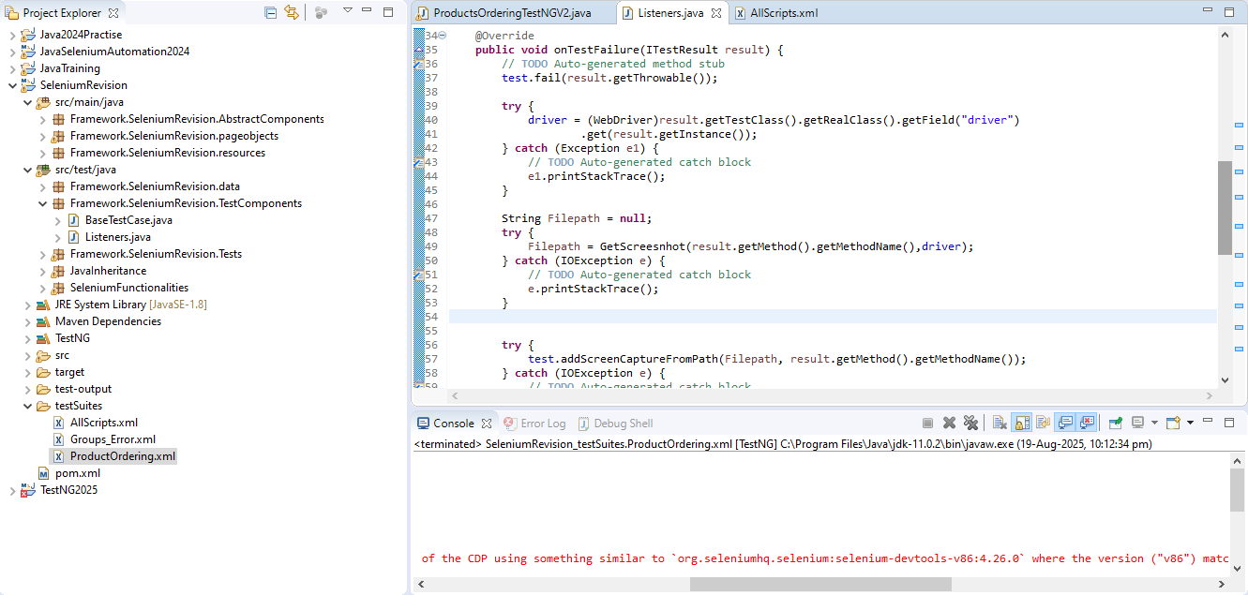
Listeners - contd
In Screenshot there are 2 steps 1.Call the Screesnhot Method to take Screenshot and get path 2.Use attach
addScreenCaptureFromPath(Path of Screenshot,Title of Test Screenshot)

Slide 12
RetryAnalyzer
Package Name - .TestComponents
Retry Class should implement IRetryAnalyzer Interface
The below code by default will return false for boolean , the if loop will run failed tc when condition is true
int startcount = 0;
int maxcount = 1;
public boolean retry(ITestResult result) {
if (startcount < maxcount) {
startcount++;
return true;
}
return false;
}
Link the Retry Class to our failed Test case using retryAnalyzer=Retry.Java

Slide 13
Test Cases
Package Name - .Tests
Create in Test/Java
This should not have any Object Creation, Action Methods and Locators
They should have only Input Data and Assertions
They should inherit Base Test as its Parent class
Test should start by using object(Declared as Global) which is created in Base Test (Method calling Initializing Driver and creating Object) for first step in SUT.
Test Cases should have Multiple @Tests based on Functionalities

Slide 14
Data Providers
DataProviders are TestNG Methods where we pass input data
Input file is passed as 2D Array
Object [] [] OrderDetails = {{"selenium@ggg.com","Hello123","ADIDAS ORIGINAL"},{"selenium@naresh.com","Hello234","ZARA COAT 3"}};
HashMap<String,String> map1 = new HashMap();
Object [] [] MapOrderDetails = {{map1},{map2}};
JSON Format – Create .json File inside .data Package
Create a class in Base Tests to create a utility to access this Json file
String JsonContent = FileUtils.readFileToString(new File (System.getProperty("user.dir")+"\\src\\test\\java\\NareshJavaSelenium\\data\\PurchaseOrder.json"),StandardCharsets.UTF_8);
ObjectMapper mapper = new ObjectMapper();
//ReadValue converts String to HashMap and put into list
List<HashMap<String,String>> data = mapper.readValue(JsonContent, new TypeReference<List<HashMap<String,String>>>() {});
return data;

Slide 15
TestNG Parameters in Test Case
@Test
@BeforeMethod
@AfterMethod
@Test(dependsOnMethods={“DependentTestMethodName without ()”}) – will run only after running Method in {}
@Test(groups={“Regression”}) – include this group name in POM XML file(Groups_run_Include) to run based on Group Tag
@BeforeMethod(alwaysRun=true) – this will run always irrespective of any rules
@DataProvider – To pass Input Data and @Test(dataProvider=“Method Name without()”)
@Test(groups={“Regression”},retryAnalyzer=Retry.class) – include this in Test Cases where we need to Retry after Failures

Slide 16
POM XML Parameterization
Part of Package .testsuites inside Project Folder
Run all Test/Methods in Parallel
<suite parallel = "tests/methods" name="Suite">
Run Methods with Groups names Tagged in Test Cases
<groups>
<run>
<include name="LoginError"/>
</run>
</groups>
Classes = Test Cases
<test thread-count="5" name="Valid Scenario">
<classes>
<class name="Framework.Selenium.Tests.ProductsOrderingTestNGV2" />
</classes>
</test>
<listeners>
<listener class-name="Framework.SeleniumRevision.TestComponents.Listeners"/>
</listeners>

Slide 17
Selenium TestNG Dependencies
Webdriver Manager – Chromedriver Manager Dependencies
Selenium – Selenium Dependencies
TestNG – TestNG Dependencies
Jackson databind – to take Json Input file and extract to String into Hashmap format
ExtendReport – To Generate report from our Test cases

Slide 18
OOPS
Inheritance – POC Inherits Abstract Components and Test Cases inherits Base Test
Encapsulation –Object Creation is done in POC and Base Tests encapsulating it from Test cases

Slide 19
GIN – Push Code for New Repo
https://confluence.atlassian.com/bitbucketserver/basic-git-commands-776639767.html
https://github.com/Naresh0608/SeleniumTestNG.git
git config --global user.name "Naresh Kumar"
git config --global user.email "nareshkumar06081989@gmail.com"
cd /d "E:\Office Documents Naresh\Java Tutorials\SeleniumRevision"
git init --->Initialize the Git repository
git add * ----->Staging
git commit -m "Selenium Learning Project Committed" ----->Commit the code with msg
git remote add origin https://github.com/Naresh0608/SeleniumTestNG.git -----> to connect to remote Git Repository
git push origin master ---> Push code to Master Branch , master corresponds to branch name

Slide 20
GIN – Pull Code for New Repo
https://confluence.atlassian.com/bitbucketserver/basic-git-commands-776639767.html
https://github.com/Naresh0608/SeleniumTestNG.git
git checkout –b develop ----→ to switch to branch develop which is not developed
git pull origin master ---> Push code to Master Branch , master corresponds to branch name
git checkout develop ----→ to switch to branch develop which is already developed
Git checkout master →will switch to master branch and then git merge develop-→ will merge the code to master branch

